Slide 1
INTRODUCTION TO THE FINAL ASSIGNMENT

Slide 2
WHAT ARE WE GOING TO DO THIS CLASS?
Look back on previous class
Introducing final task
Look at examples
What would you want to include in your task

Slide 3
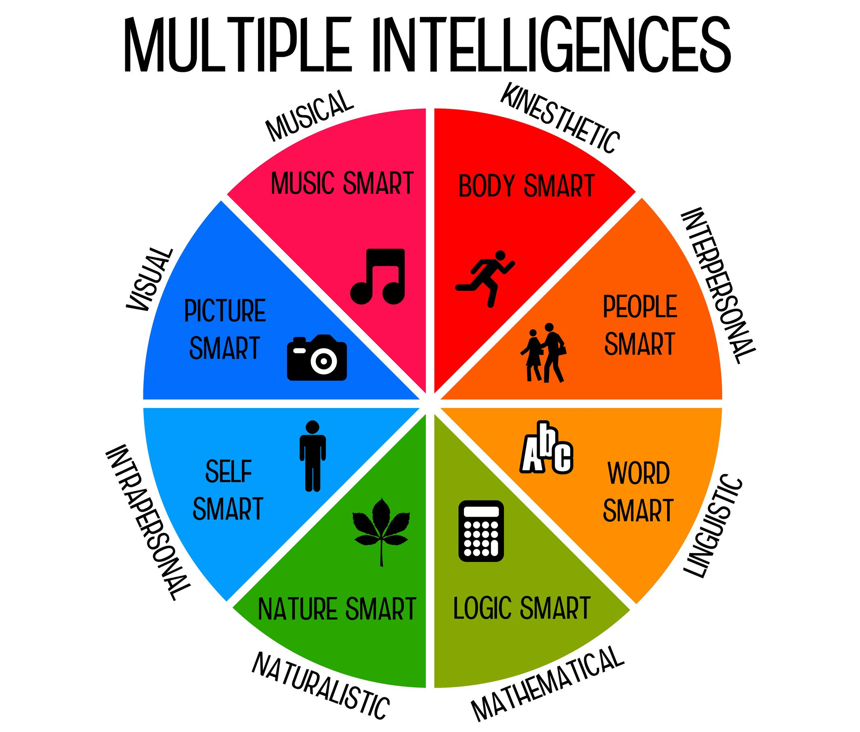
PREVIOUS CLASS
Multiple Intelligence
Homework: the letter to a pen pal
How is your vocab?

Slide 4
THE FINAL TASK
You will make a brochure or video about Walt Disney World
- In groups of 3
- At least 5 attractions
- Timetable
- Pricing
Requirements:
- Vocab
- Try to use proper English
- Make it understandable to others
- 250-500 words or 3-7 minutes

Slide 5
EXAMPLES

Slide 6
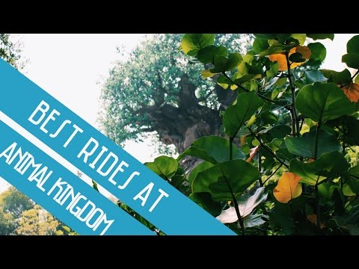
EXAMPLES CONTINUED
https://www.youtube.com/watch?v=nEGEHcHGVs8
Notes:
Na deze dia de hand-out uitdelen. https://docs.google.com/document/d/1-YIQfEMuKMZtLi__NRJhl4OuOltTY-zV-U5CPvhVXso/edit?usp=sharing

Slide 7
STARTING WITH YOUR TASK
What did you find interesting?
What parts would you want to add to your own product?

Slide 8
HOMEWORK
Start to work on a draft for your product

